Slide 1
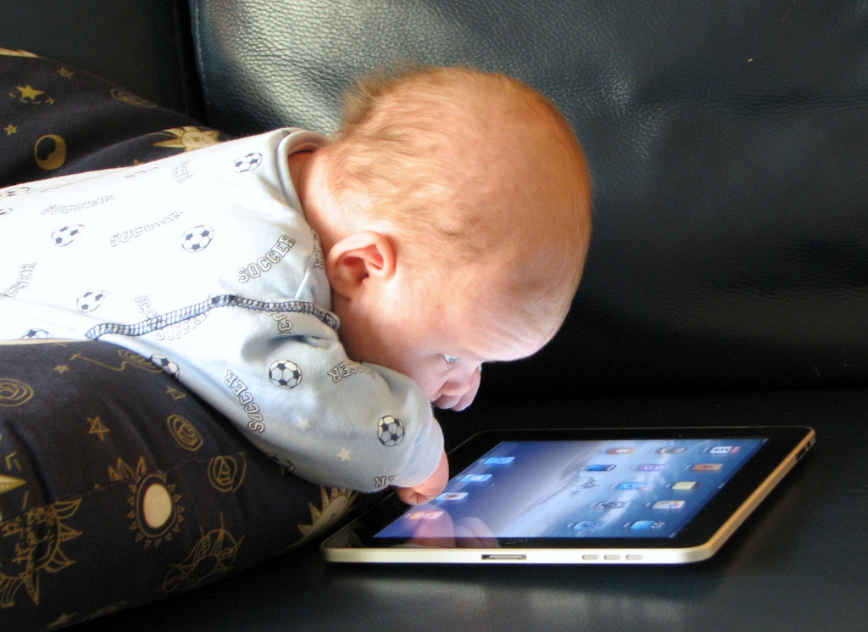
Depth of Experiences
Lack of depth in interpersonal interactions causing people to feel less connected
Overstimulation creates a lack of time to have deeper interactions
In terms of Big Data this attitude can cause individuals to be treated as data points instead of humans

Slide 2
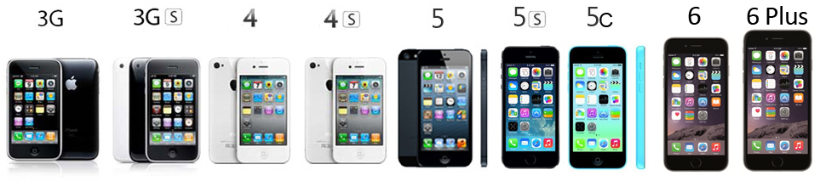
A Tedious Monotony
Making sure that advances in technology are actually meaningful instead of superficial
The cycle of new products and technologies are less meaningful (are you getting the new iPhone? Vs. Do you have a car?)
How do these new advancements actually improve quality of life

Slide 3
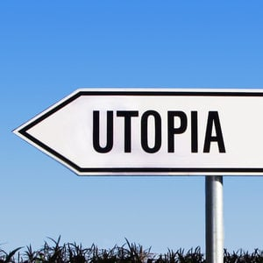
No Belief in a Happy Future
Progress in Tech/Science is no longer Progress in Humanity/History
A growing sense that a better future lies elsewhere
Ethical responsibility of people developing the tech to ensure that advances are in the interest of creating a happy future
Racial bias in policing example

